Slide 1
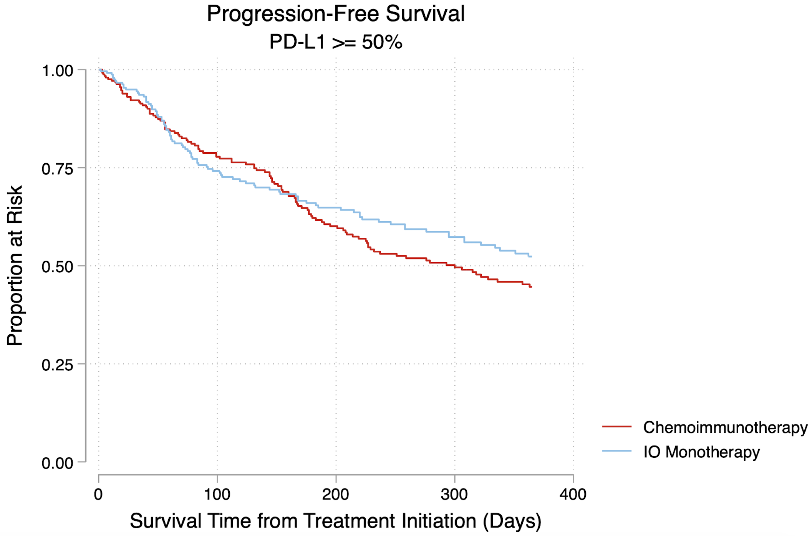
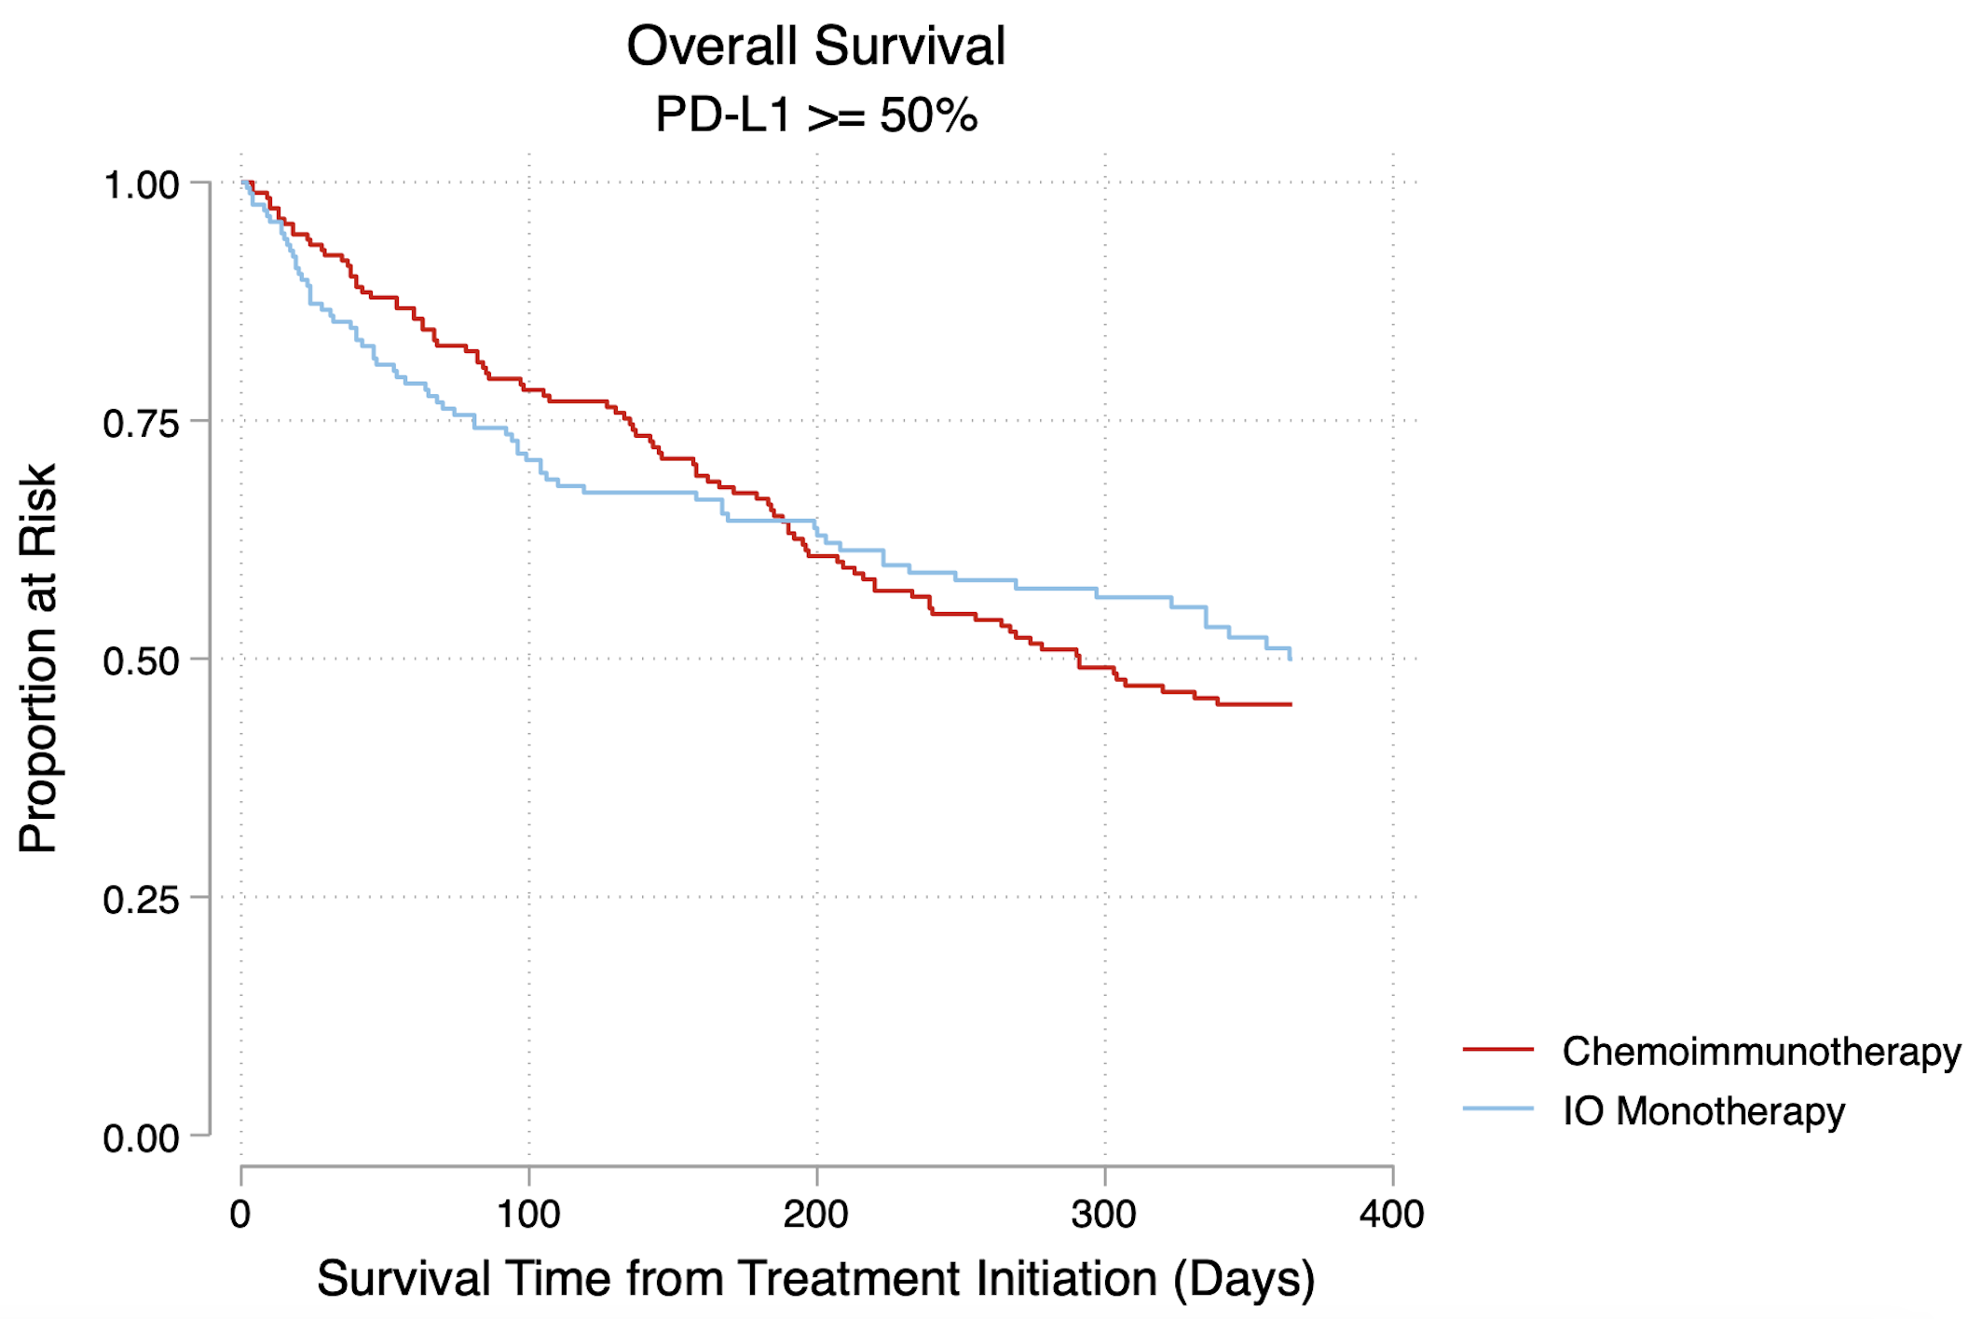
a)
b)
Hazard Ratio: 0.86 (0.65, 1.13)
Hazard Ratio: 0.95 (0.70-1.29)
Log-rank p-value = 0.27
Log-rank p-value = 0.73

Slide 2
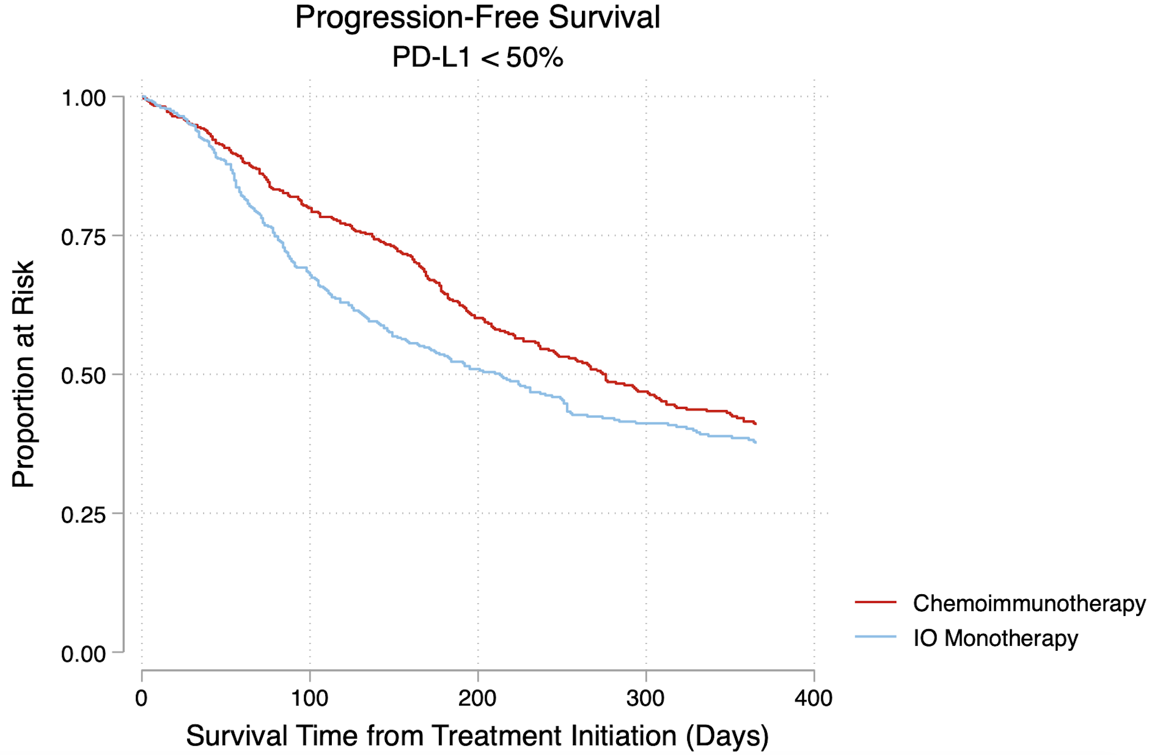
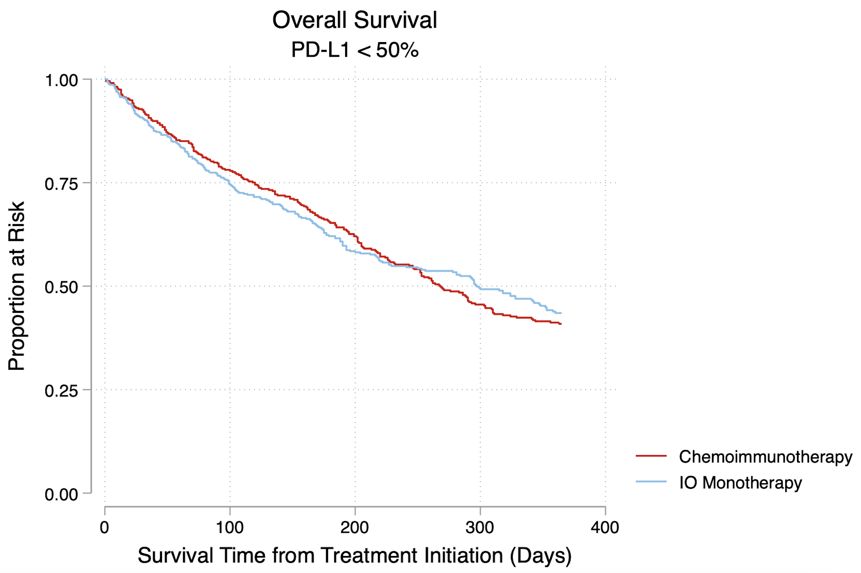
c)
d)
Hazard Ratio: 1.25 (1.05-1.49)
Hazard Ratio: 0.97 (0.81-1.17)
Log-rank p-value = 0.01
Log-rank p-value = 0.78

